Slide 1
Newton's Law of Universal Gravitation

Slide 2
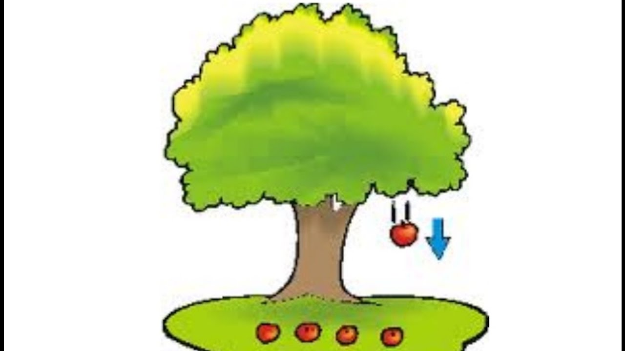
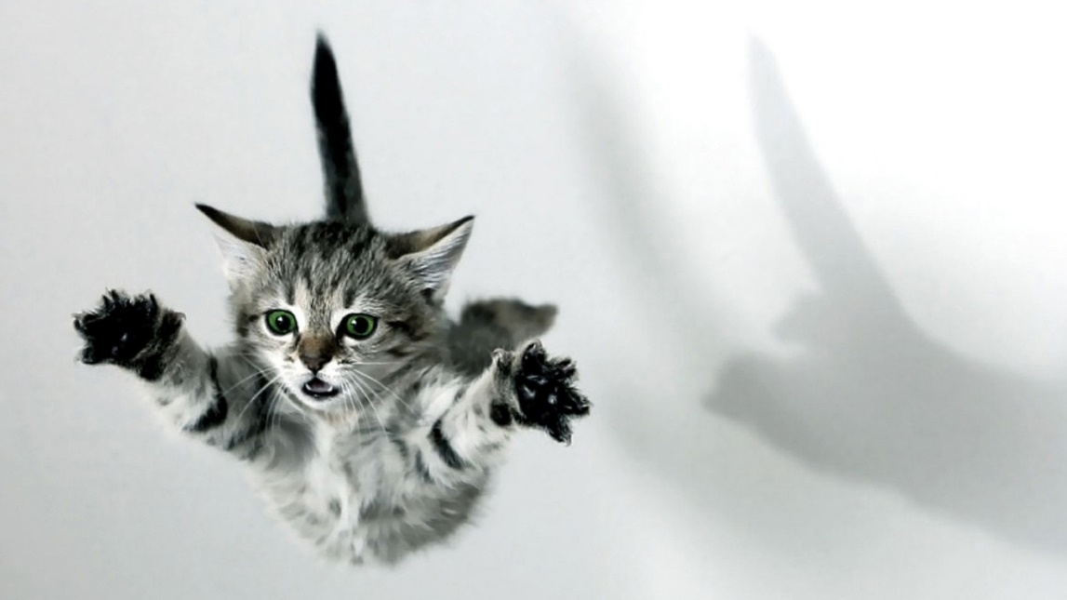
Why does the apple (cat) fall?
What is gravity?
The force of gravity is the force with which the earth, moon, or other massively large object attracts another object toward itself.

Slide 3
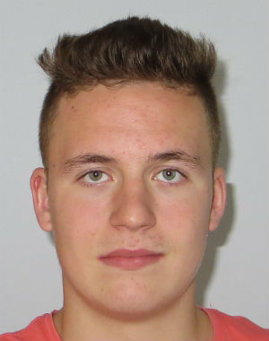
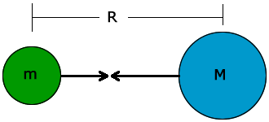
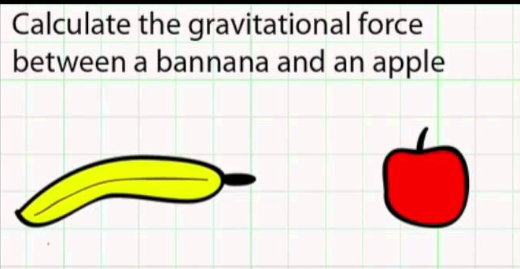
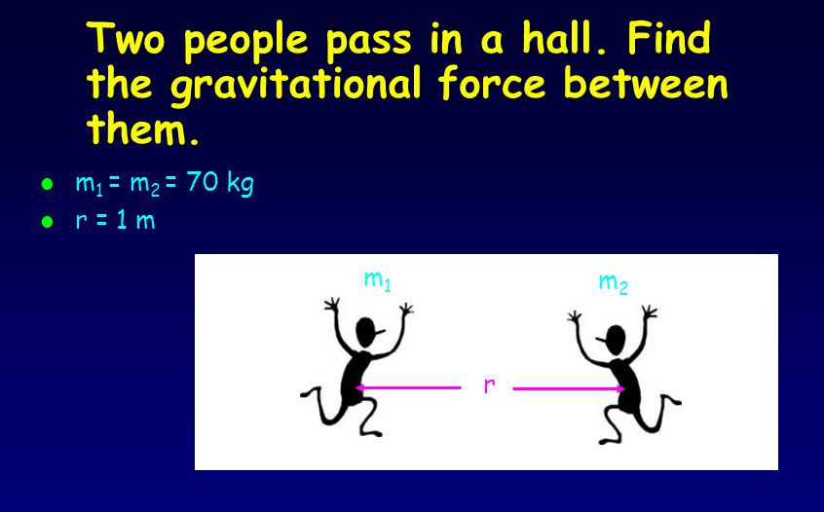
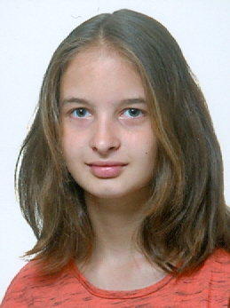
Newton's law of universal gravitation - 1686
extends gravity beyond earth
is about the universality of gravity
ALL objects attract each other with a force of gravitational attraction
Gravity is universal

Slide 4
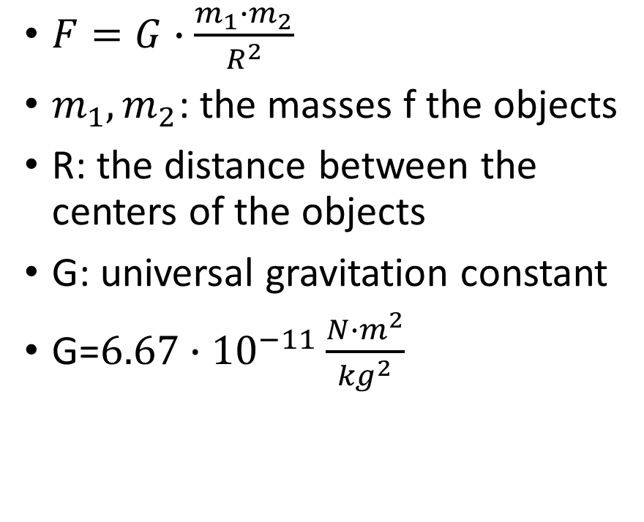
Newton's law of universal gravitation
This force of gravitational attraction is
directly dependent upon the masses of both objects
and inversely proportional to the square of the distance that separates their centers.
$F=G∙\frac{m_{1}∙m_{2}}{R^{2}}$
$m_{1}, m_{2}$: the masses f the objects
R: the distance between the centers of the objects
G: universal gravitation constant
G=$6.67∙{10}^{−11}\frac{N∙m^{2}}{{kg}^{2}}$

Slide 5
Determining the value of G
www.youtube.com/watch?v=4wt0135G8kM
www.youtube.com/watch?v=jkjqrlYOW_0
www.youtube.com/watch?v=Ym6nlwvQZnE&t=14s
www.youtube.com/watch?v=rpH5I9fN1sI

Slide 6
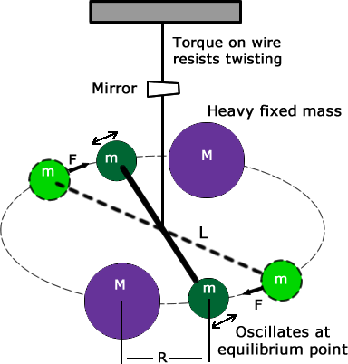
Henry Cavendish
the first experiment to measure the force of gravity between masses in the laboratory
in 1797–1798

Slide 9
Problem 1.
Determine the force of gravitational attraction between the earth (M = 5.98 x 10²⁴ kg) and a 70-kg physics student if the student is standing at sea level, a distance of 6.38 x 10⁶ m from earth's center.

Slide 10
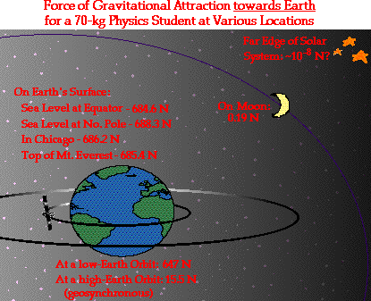
Problem 2.
Determine the force of gravitational attraction between the earth (m = 5.98 x 10²⁴ kg) and a 70-kg physics student if the student is in an airplane at 12 km above earth's surface. This would place the student a distance of 6.39 x 10⁶ m from earth's center.

Slide 11

Problem 3.
Find the force of gravitational attraction between the Earth and the Moon. The mass of the Earth is $6∙{10}^{24}kg$, the mass of the Moon is $7∙{10}^{22}kg$, the distance between them is $384 000 km$.

